Slide 1
TAX APPEAL SEMINAR
John Peneda, CTA
Salvatore Roccaro, Esq.

Slide 2

Common Reasons Property Owners File a Tax Appeal
My taxes are too high!
I want to lower my taxes!
What can I do to lower my taxes?
My neighbor is paying less taxes than me!
My taxes keep going up every year!
My property value is less than a few years ago, so why are my taxes still rising?

Slide 3

What is a Tax Appeal?
Property owners are not appealing their taxes
Property owners are appealing their property assessment
Current assessment is by law assumed to be correct
The burden of proof is on the property owner to prove that their property is unreasonably assessed
Property owner must present credible evidence, supported by facts, not assumptions or beliefs
Assessments of other properties are not acceptable as evidence of value
Comparable property sales and/or a property appraisal must be used

Slide 4
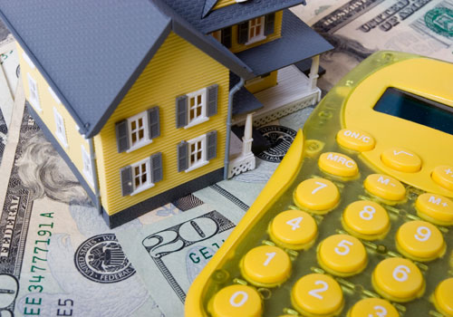
Property Assessment
October 1st of Pre-Tax Year
Land Assessment
Improvement Assessment
Total Assessment
Ratio
Market Value
15% Window/Corridor Ratio
Lower Value

Slide 5
Property Assessment Example
Land Assessment $28,000
Improvement Assessment $75,400
Total Assessment $103,400
2015 Kearny Ratio 31.01
Market Value $333,441
15% Window/Corridor Ratio 35.66
Lower Value $289,961
For Tax Appeal purposes, property owner needs to prove that his/her property is worth less than $289,961 in order to be granted a reduction

Slide 6
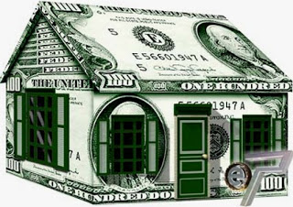
Tax Rate
How is the Tax Rate derived?
How does the Tax Rate apply to the assessment?
Kearny’s Tax Rate for 2015 is 10.036
Tax Rate Example:
Total Assessment $103,400
2015 Tax Rate 10.036
2015 Property Taxes $10,377.22

Slide 7
What Determines a Tax Rate
The breakdown of the 2014 Kearny Tax Bill is:
Municipal Budget 37.56%
School Board Budget 44.56%
County Budget 16.70%
Other Minor Items 1.18%
TOTAL 100.00%

Slide 8

Market Value
What is Market Value?
How much would your property sell for, if you were to sell it today?
Willing Buyer/Willing Seller
Usable Sales/Non-Usable Sales
Comparable Sales
Property Appraisal

Slide 9
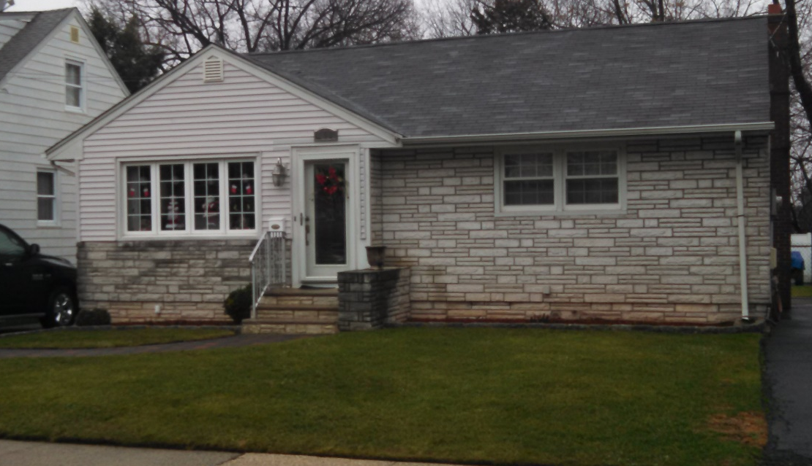
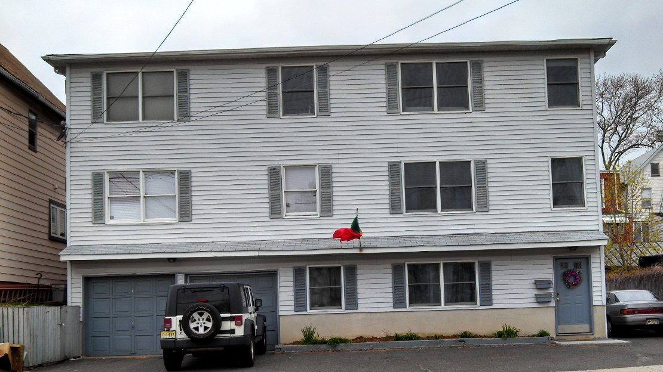
Comparable Sales
Sales that occurred between October 1st of pre-tax year and October 1st of previous year
Minimum of 3 comparable sales
Can’t mix apples and oranges
Must be Usable Sales
Factors to be considered are lot size, age, square footage of living space, number of baths and bedrooms, finished basement and/or attic, deck, patio, pool, central air, location, etc.

Slide 10

Appraisals
Must be performed by a licensed NJ appraiser
Appraisal must be for property tax appeal purposes
Valuation must be as of October 1st of pre-tax year
Appraiser must appear at hearing for appraisal to be considered
Real Estate Agents cannot testify to property value

Slide 11

Questions to Ask Before Filing a Tax Appeal
What was the market value of my property on October 1st of the pre-tax year?
What is my property assessment?
What is the ratio?
What is the market value of my assessment and the 15% window/corridor?
Is my property over assessed?
Can I support my opinion of market value with credible evidence?

Slide 12
How to File a Tax Appeal
Must be filed on or before April 1st
Can file online or with Hudson County Board of Taxation
Filing fee must be paid when appeal is filed
Property taxes must be current
Appeal can be filed by property owner or through an attorney
Notice of hearing date will be sent by the County (no adjournments, except for emergencies)
File the Tax Appeal online at:
www.njappealonline.com
or
Hudson County Board of Taxation
Hudson County Plaza
257 Cornelison Ave
3rd Floor
Jersey City, NJ 07302
Phone: 201-395-6260

Slide 13
Questions?
John Peneda, CTA
Kearny Tax Assessor
402 Kearny Avenue
Kearny, NJ 07032
201-955-7981
jpeneda@kearnynj.org
Salvatore Roccaro, Esq.
Castano Quigley, LLC
Kearny Town Attorneys
For more information contact the Hudson County Tax Board at:
(201) 395-6260 or go to www.hudsoncountynj.org/board-taxation

